Slide 1
Web Accessibility 2.0
February 4, 2015

Slide 2
Introduction:
Patrick Johnson
Internet Coordinator and Webmaster
Department of Rehabilitation
Since 1996
Phone: (916) 558-5873
Email: Patrick.L.Johnson@dor.ca.gov
Or: webmaster@dor.ca.gov (mostly me)

Slide 3
Web Accessibility History
1998 – Rehabilitation Act of 1973, amended,
New Section 508 standards adopted – www.section508.gov/
New Web-based standards in Subpart B, Sub-Section 1194.22
(also Required states to abide by Section 508)
1999 - World Wide Web Consortium (W3C),
Web Content Accessibility Guidelines (WCAG) 1.0
2001 - First State Template (508)
2003 - California Government Code 11135 (CA will abide by 508)
2005 - Governor appointed State Portal Steering Committee
Portal Review Board (included State CIO)
Information Organization, Usability, Currency, and Accessibility (IOUCA) Working Group - 3 sub-workgroups
Usability standards
Presentation and Content Separation standards
Accessibility standards (508 and W3C WCAG 1.0 AA +)
More information about the IOUCA can be found on the Webtools website at webtools.ca.gov. Look under “Web Content”, and then “Accessibility”.

Slide 4
Web Accessibility History
2006 - Portal Review Board and the State Portal Steering Committee adopted all IOUCA standards.
2006 - Second State Template
Used IOUCA standards
2008 - W3C WCAG 2.0
2010 - Third State Template (508 & WCAG 1.0)
2013 - Fourth State Template (508 & WCAG 1.0)
2015? - Access Board update to 508
To reflect W3C WCAG 2.0 AA
February 2014 - Proposed rule submitted for review Office of Management and Budget (OMB)
Court Cases around the ADA and WCAG 2.0

Slide 5
What are we NOT going to talking about?
Documents
Word and Forms
www.dor.ca.gov/DisabilityAccessInfo/DAS-Trainings.html
PDF
webtools.ca.gov/web-content/web-accessibility/how-to-implement/#pdf
Make it a webpage, if you can (RTF, PDF)
Why do we do this?
Screen Reader and Zoom softwares (except for testing)

Slide 6
What Are We Talking About?
How do end users access information?
Browsers
HTML
Generated HTML
(PSP, ASP, ARIA, C#, VB, MySQL, Silverlight…)
Screen Readers
Read HTML
(www.csszengarden.com)
Magnifying Software (Zoom Text,…)
Reads the page

Slide 7
Let’s Dive In
WCAG 2.0 Accessibility organized under 4 principles:
Perceivable
Operable
Understandable
Robust

Slide 8
Perceivable
Provide text alternatives for non-text content.
Provide captions and other alternatives for multimedia.
Create content that can be presented in different ways, including by assistive technologies, without losing meaning.
Make it easier for users to see and hear content.

Slide 9
Operable
Make all functionality available from a keyboard.
Give users enough time to read and use content.
Do not use content that causes seizures.
Help users navigate and find content.

Slide 10
Understandable
Make text readable and understandable.
Make content appear and operate in predictable ways.
Help users avoid and correct mistakes.

Slide 11
Robust
Maximize compatibility with current and future user tools.

Slide 12
Testing
Get a screen reader –
Window Eyes (Free?) - www.windoweyesforoffice.com/
JAWS (Job Access With Speech) Free Demo - www.freedomscientific.com/Downloads/ProductDemos/#JAWS
Accessibility Checkers
Only check about 25 - 30%
The rest must be checked by humans

Slide 13
Reading Resources – Why do we do this?
It’s the right thing to do. Comparable access for everyone.
Government Code Section 11135-11139.7
www.leginfo.ca.gov/cgi-bin/displaycode?section=gov&group=11001-12000&file=11135-11139.7
State Administrative Manual Section 4833
www.documents.dgs.ca.gov/sam/SamPrint/new/sam_master/rev427sept14/chap4800/4833.pdf
State Information Management Manual Section 25
www.cio.ca.gov/Government/IT_Policy/pdf/SIMM_25_IT_Accessibility_Resource_Guide_06292011.pdf

Slide 14
Working Resources – How do we do this?
Color Wheel
gmazzocato.altervista.org/colorwheel/wheel.php

Slide 15
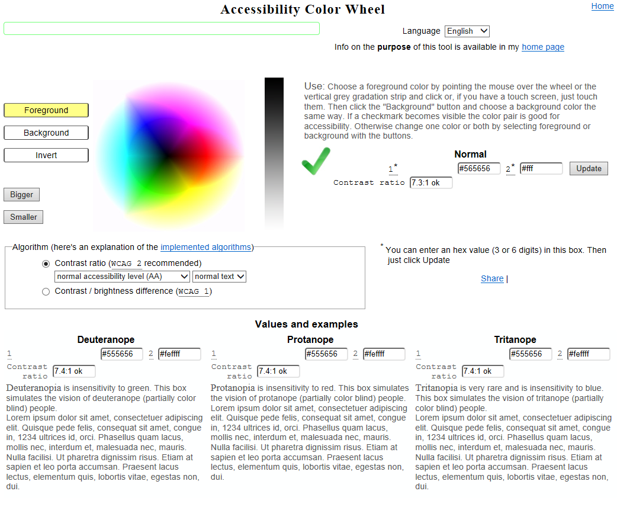
Accessibility Color Wheel Screen Shot gmazzocato.altervista.org/colorwheel/wheel.php

Slide 16
Working Resources – How do we do this?
Section 508 – www.section508.gov
W3C WCAG 2.0 Customizable Quick Reference
www.w3.org/WAI/WCAG20/quickref/
Includes techniques and “Understanding Documents” for each guideline.
Law requires AA compliance.

Slide 17
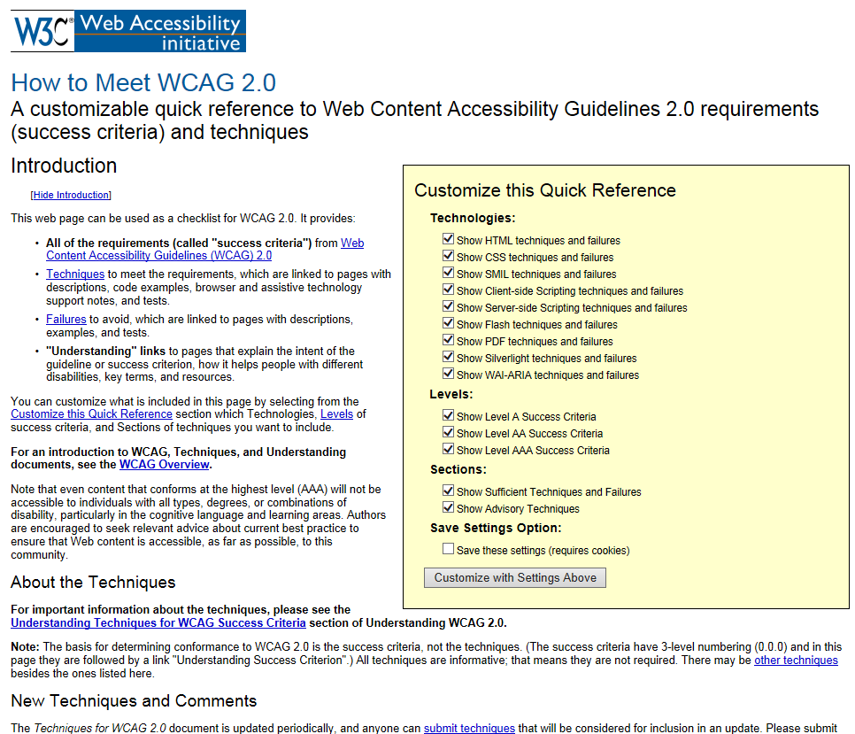
WCAG 2.0 quickref Screen Shot www.w3.org/WAI/WCAG20/quickref/

